Slide 1


Tinder Trails No Sparks allowed
GitHub: https://github.com/wanfangchou/tindertrails-project
Chris Hernandez, Claudia Caceres
Joe Gorfinkle, Wan-Fang Chou
IST 303 Software Development
May 8, 2019

Slide 2
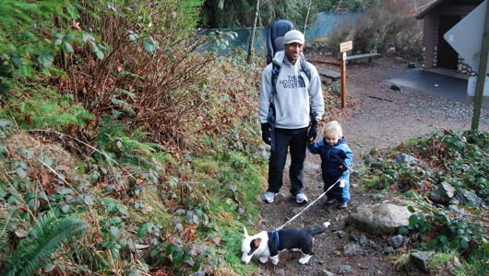
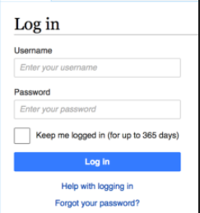

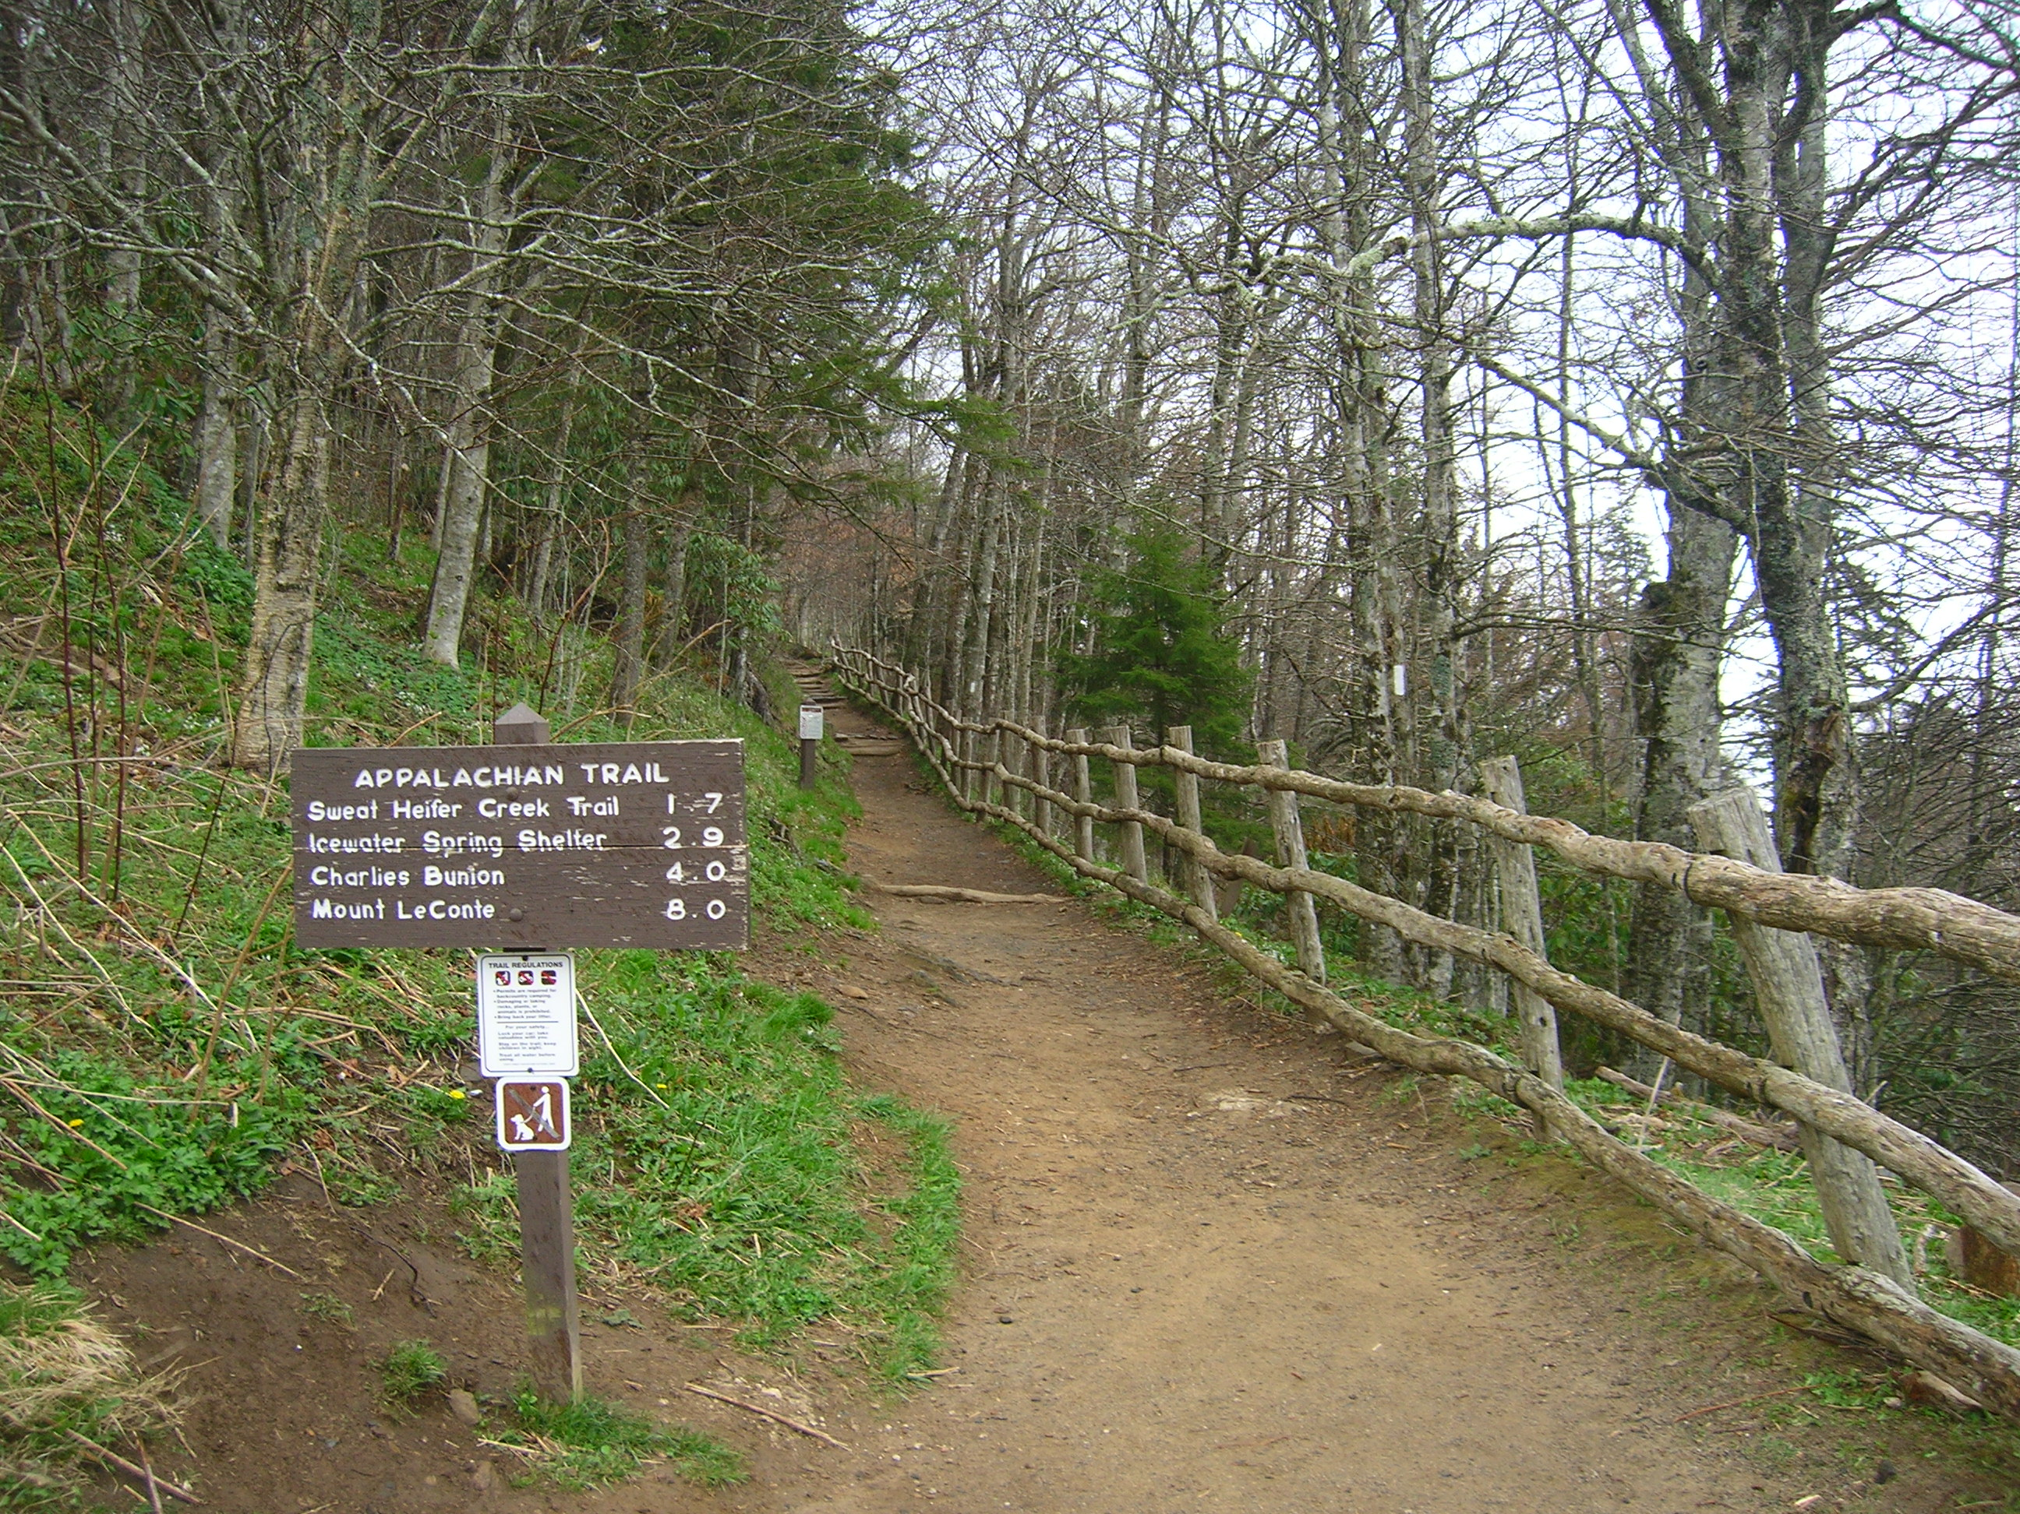
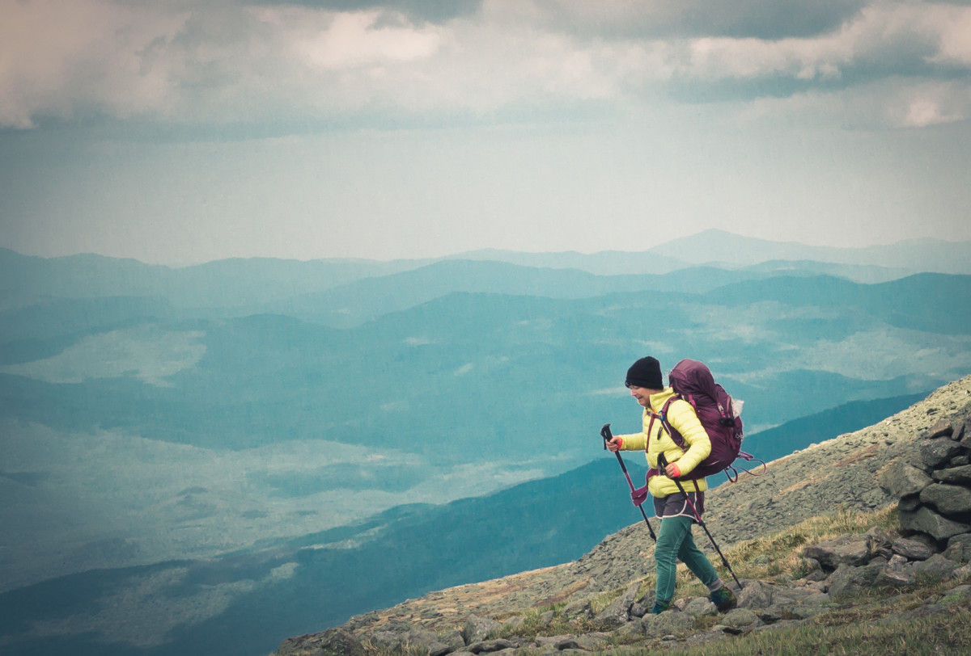


MAIN PAGE
User selects
1 of 4
Child/Dog Friendly
Nearby
Your Spec
Equipment

Slide 3









TRAIL AMENITY PAGE

Slide 4
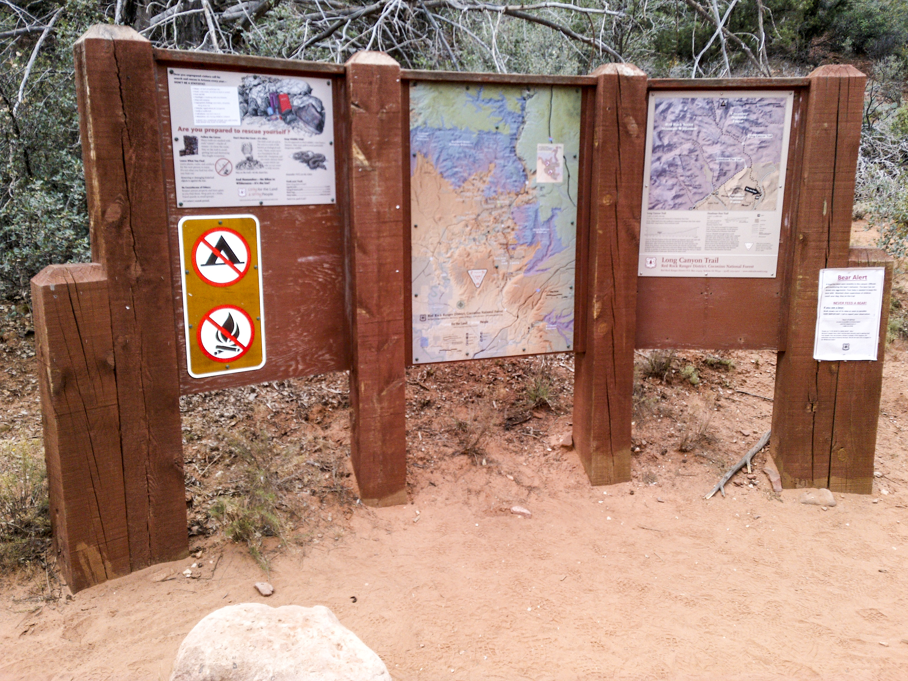
TRAIL INFORMATION PAGE
TRAIL NAME
- length (meters, miles)
- difficulty (easy, moderate, difficult)
- average slope
- total elevation rise
- peak elevation
- estimated round trip time
- reviews/ratings
- mountain bikes / motorized vehicles prohibited

Slide 5
“As a hiker…”
User Stories
I want to find an easy trail
I want to find a challenging trail
I want to find ADA accessible trails
I want to find dog/kids friendly trails
I want to view the times/hours of a trail
I want to find trails with wildlife
I want to find trails with restrooms
I want to know the elevation profile of a trail
I want to find all trails
I want to add a trail

Slide 6
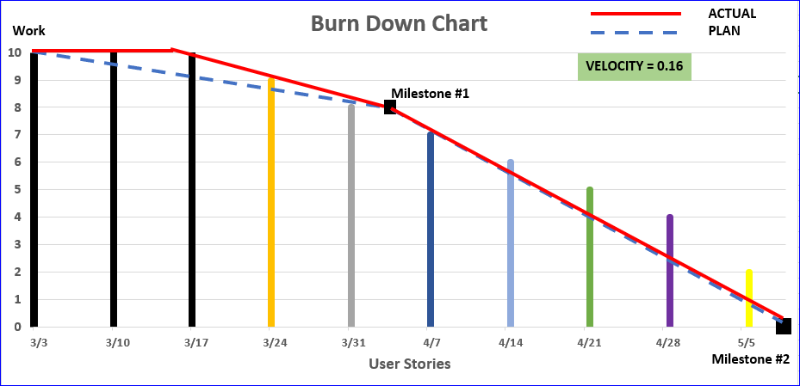

Slide 7






DEVELOPMENT
ENVIRONMENT

Slide 9
Demo Django Login & ArcGIS connector & code walk through
Demo Hiking Trail Features & code walk through

Slide 10
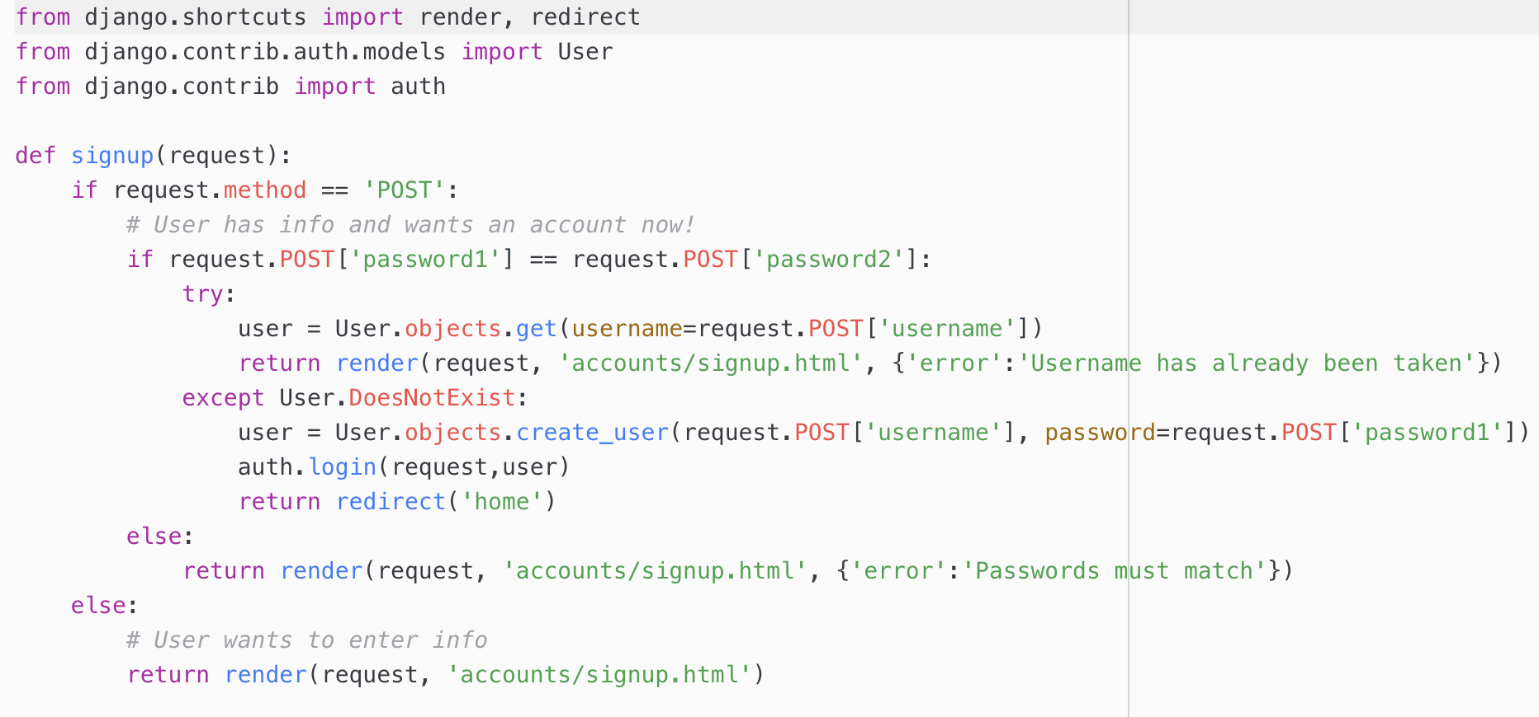
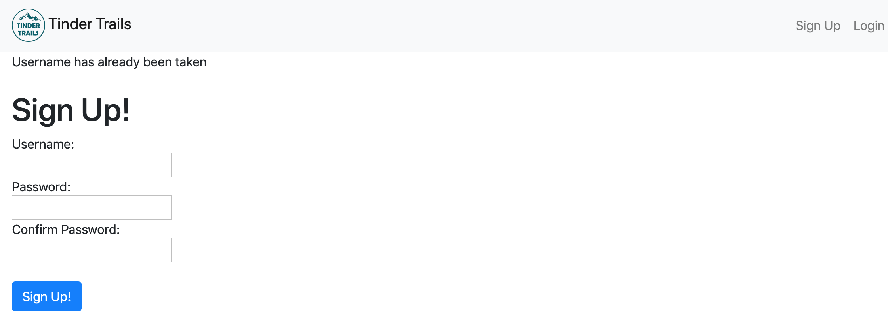
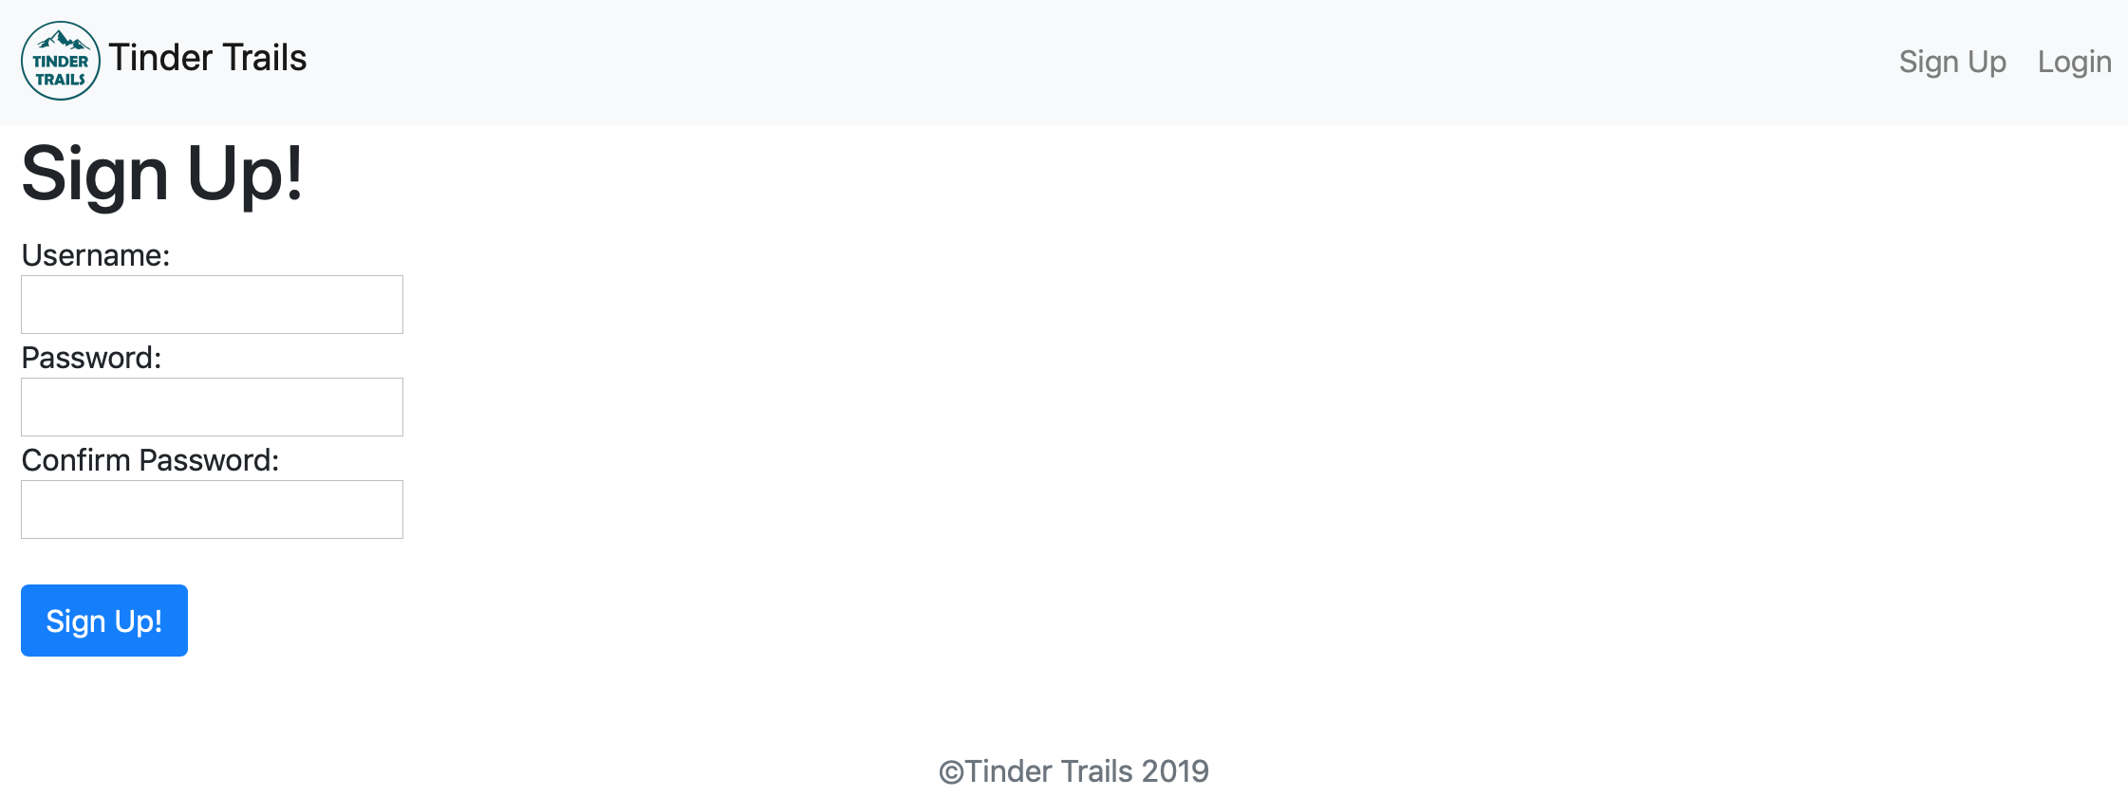
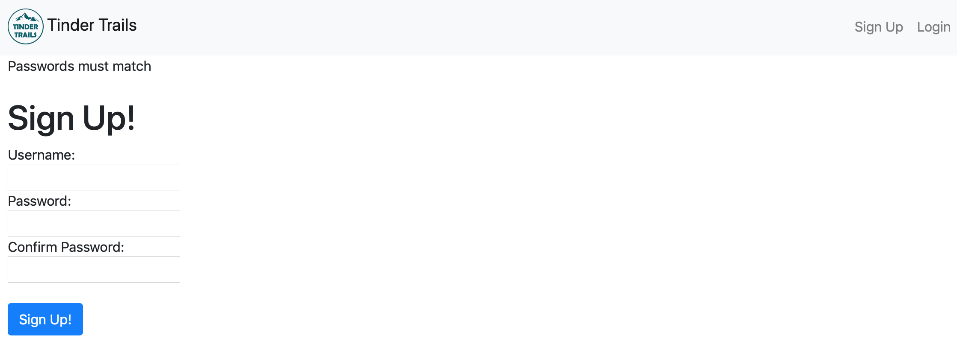
From Milestone 1.0 …
User Authentication: Sign up, Login, Logout
(views.py)
Username has been taken:
Passwords must match:

Slide 11
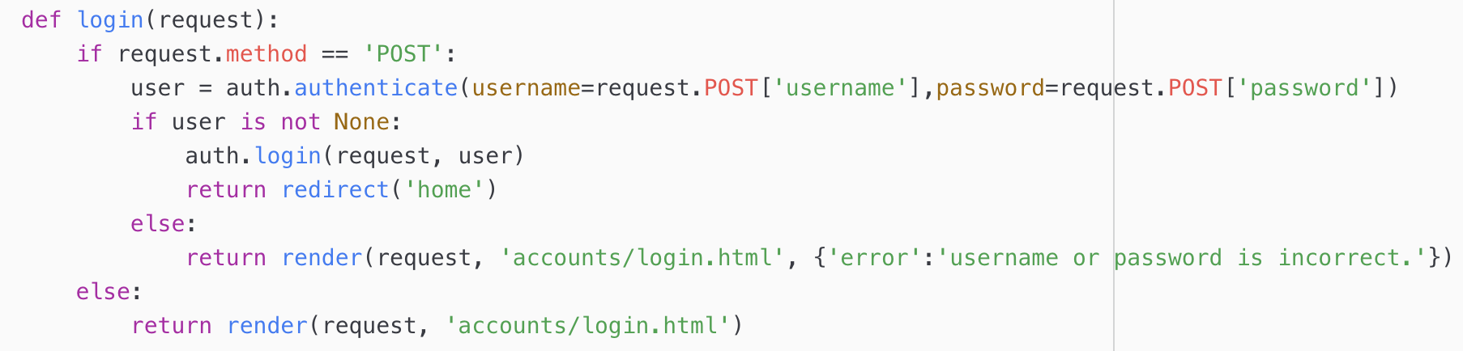
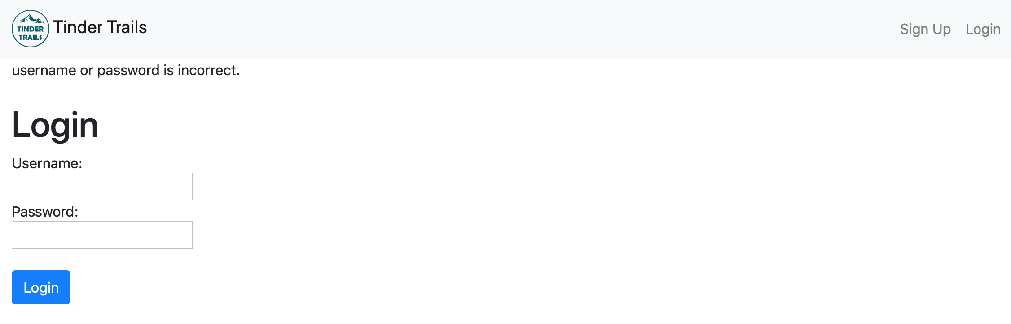
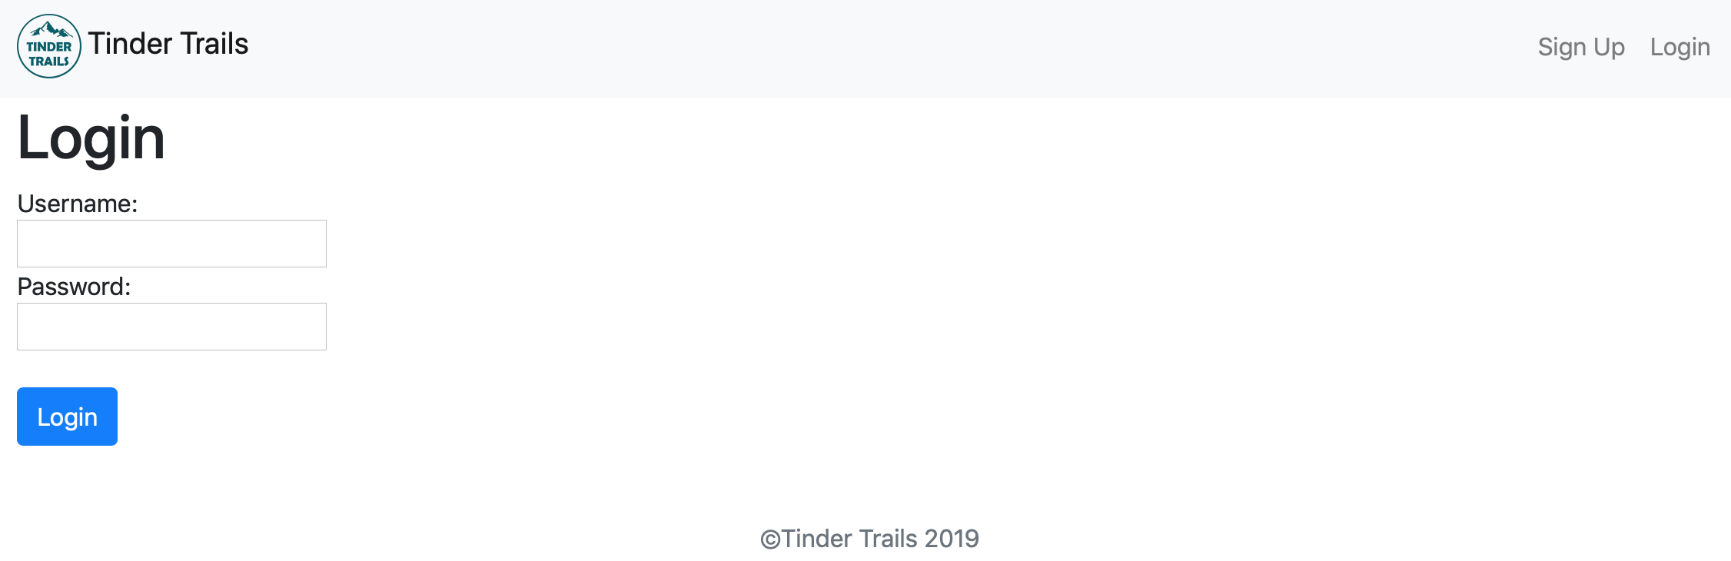
From Milestone 1.0 …
User Authentication: Sign up, Login, Logout
(views.py)
Not a user or wrong username or password

Slide 12
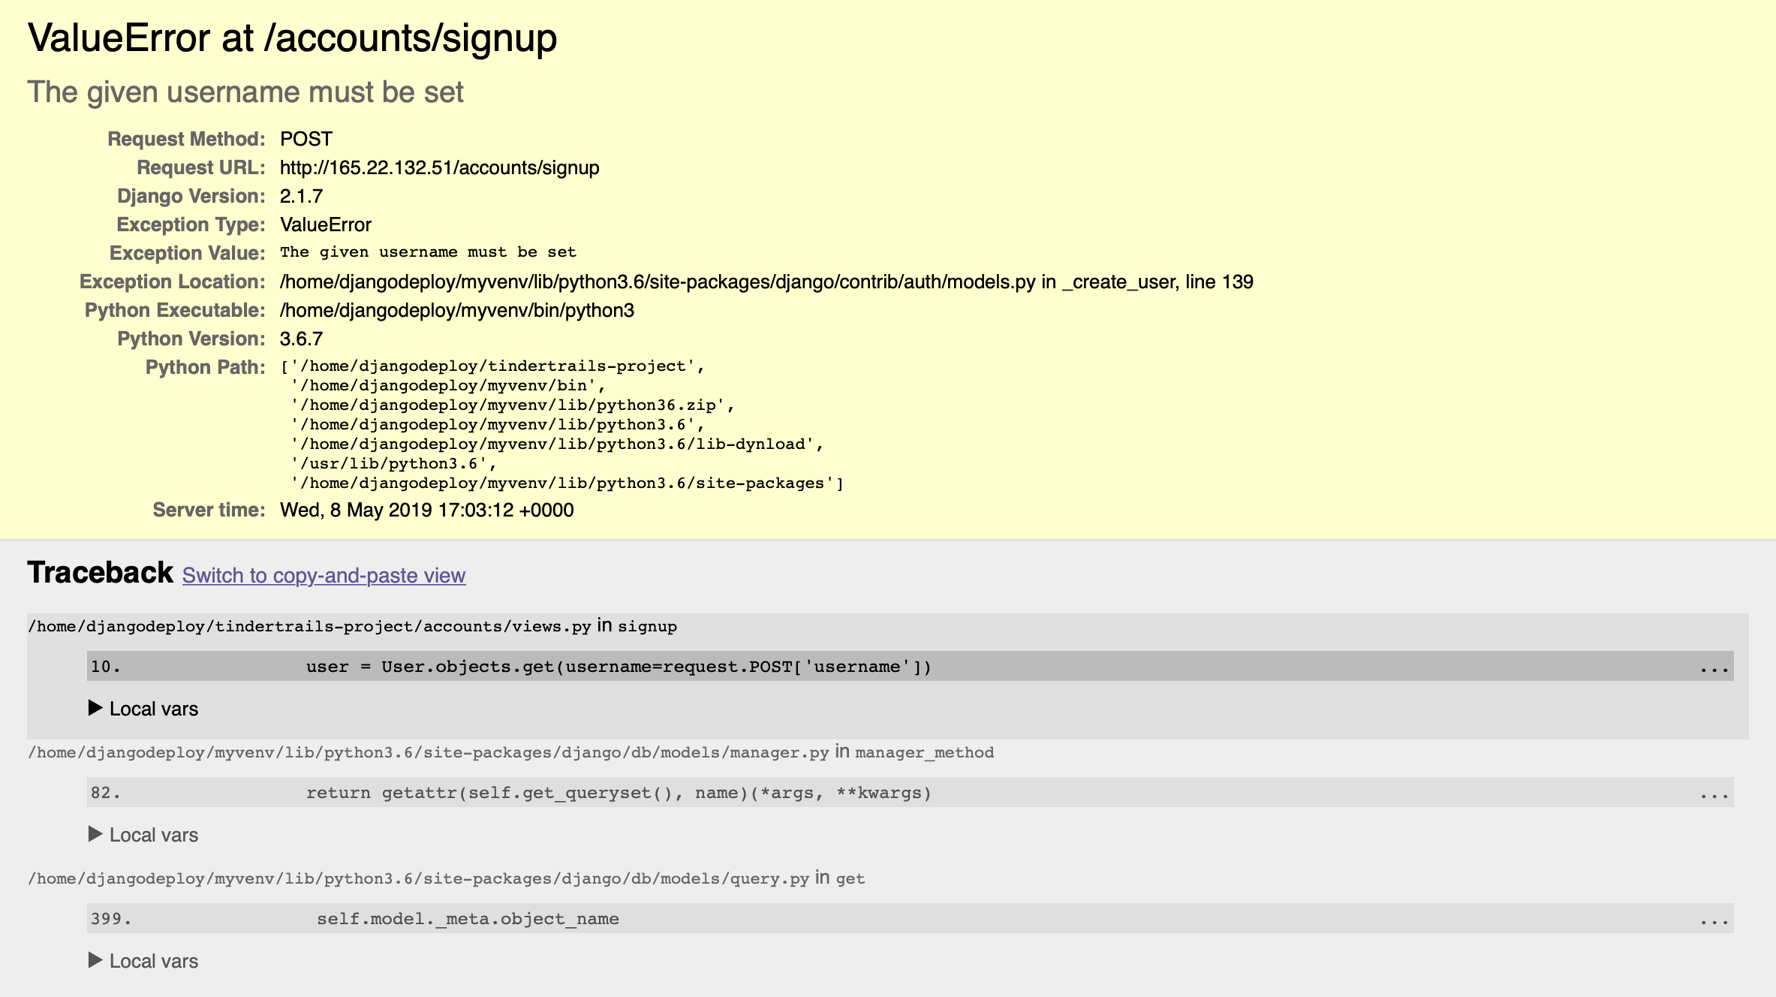
Debug: Sign up without Filling out the Information

Slide 13
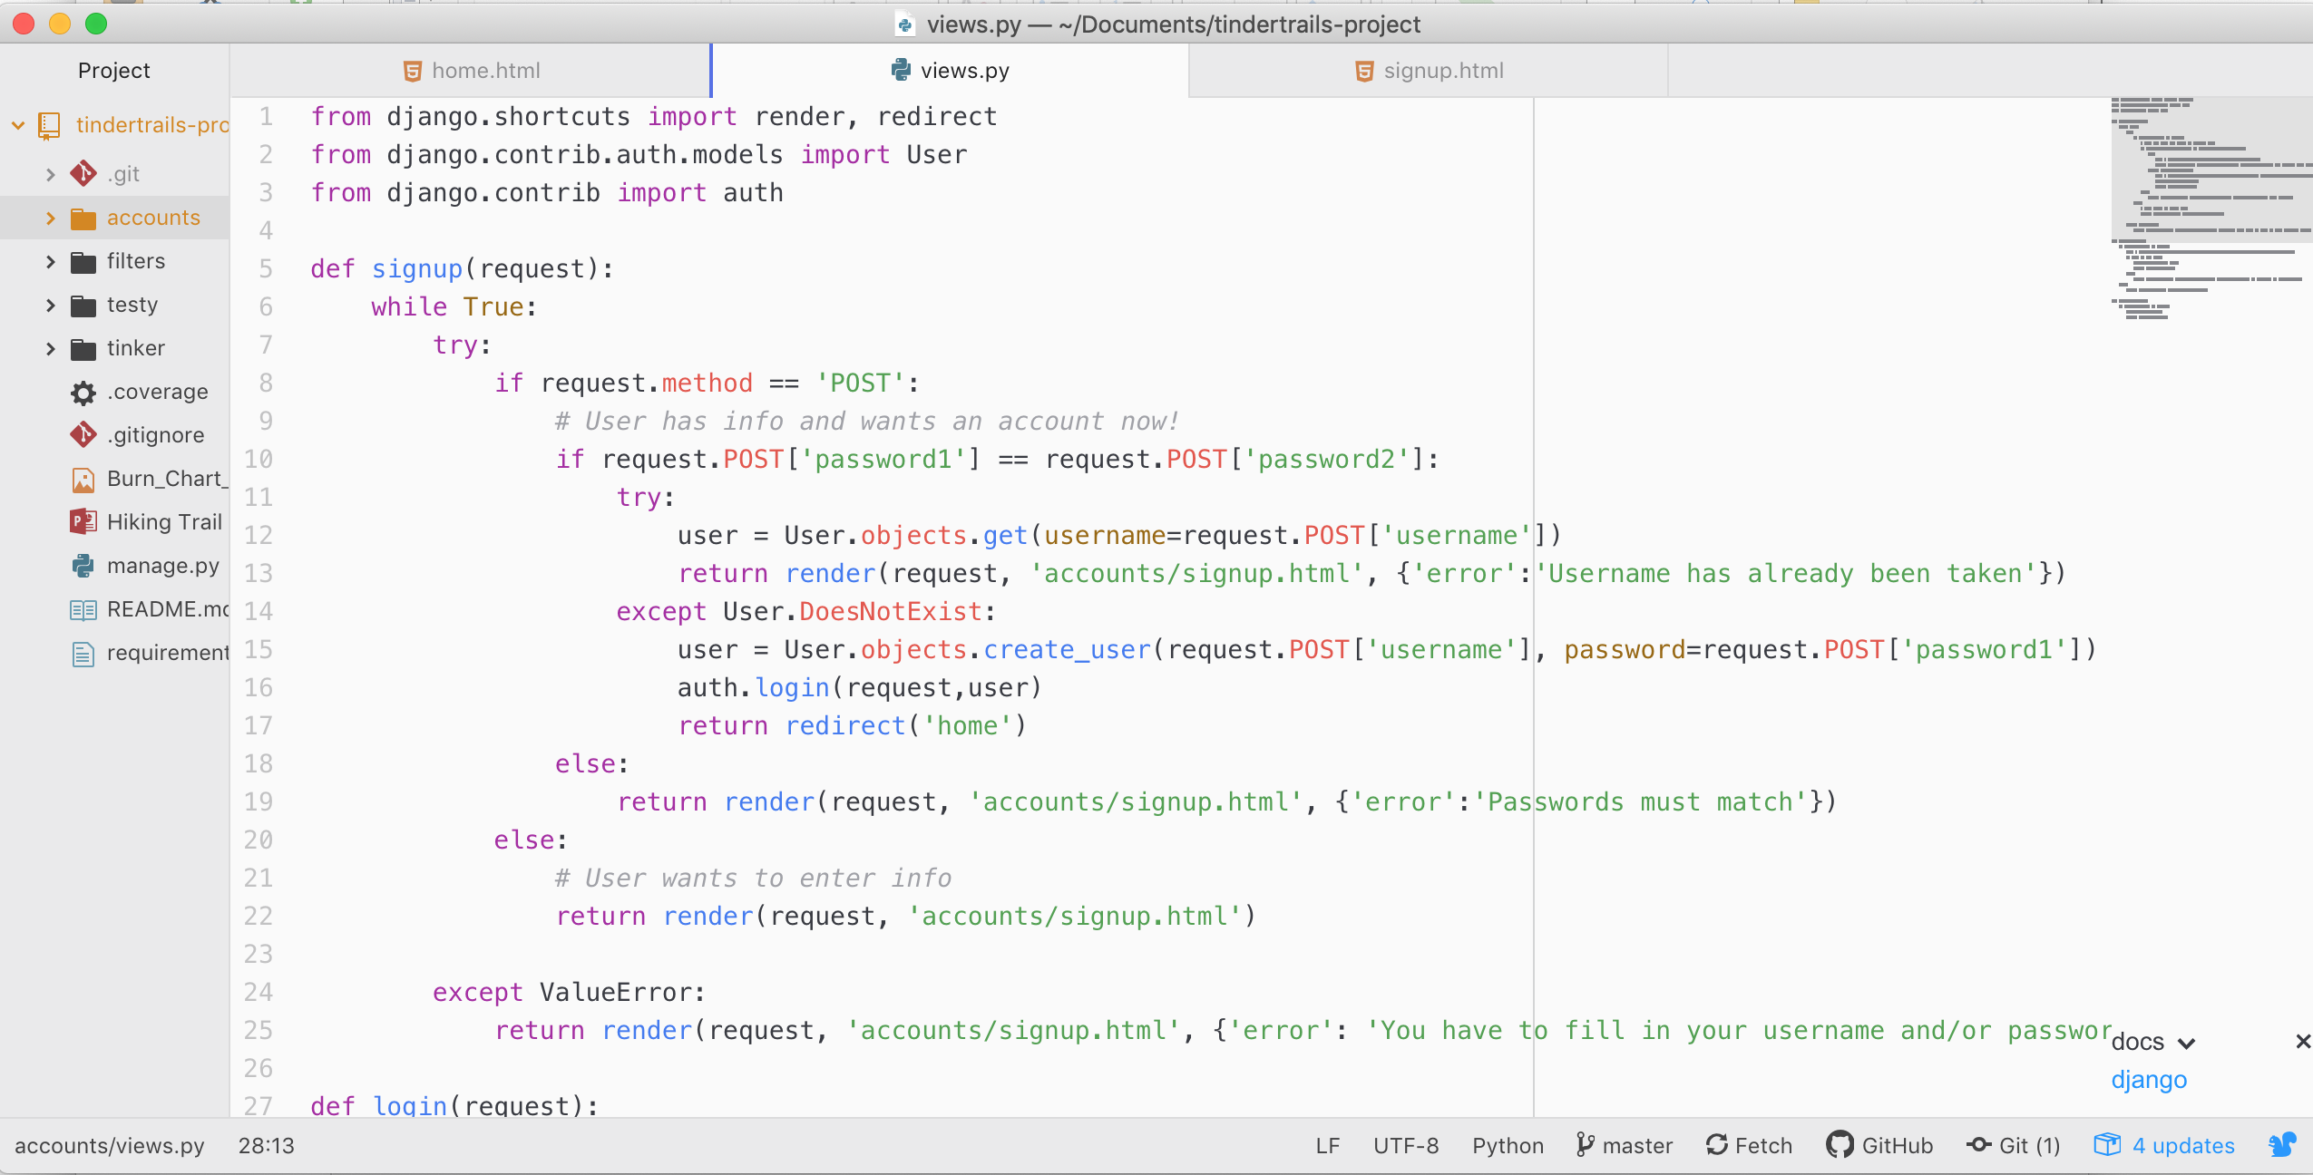
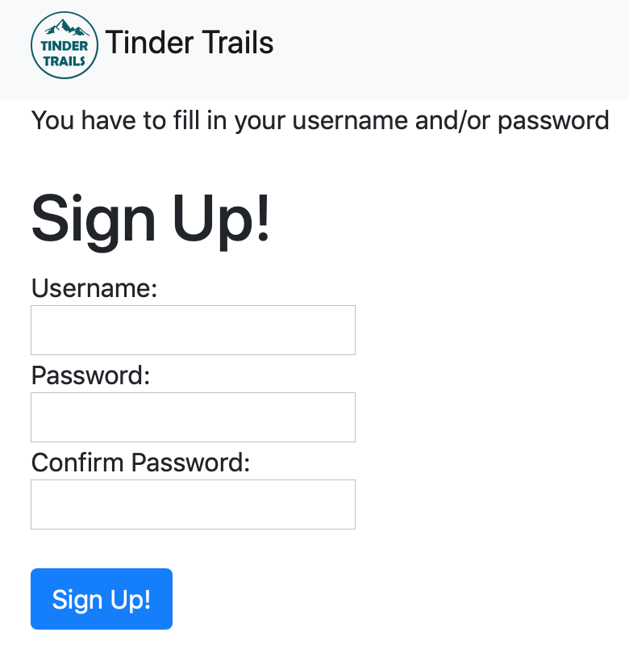
Debug: Sign up without Filling out the Information
(views.py)

Slide 14
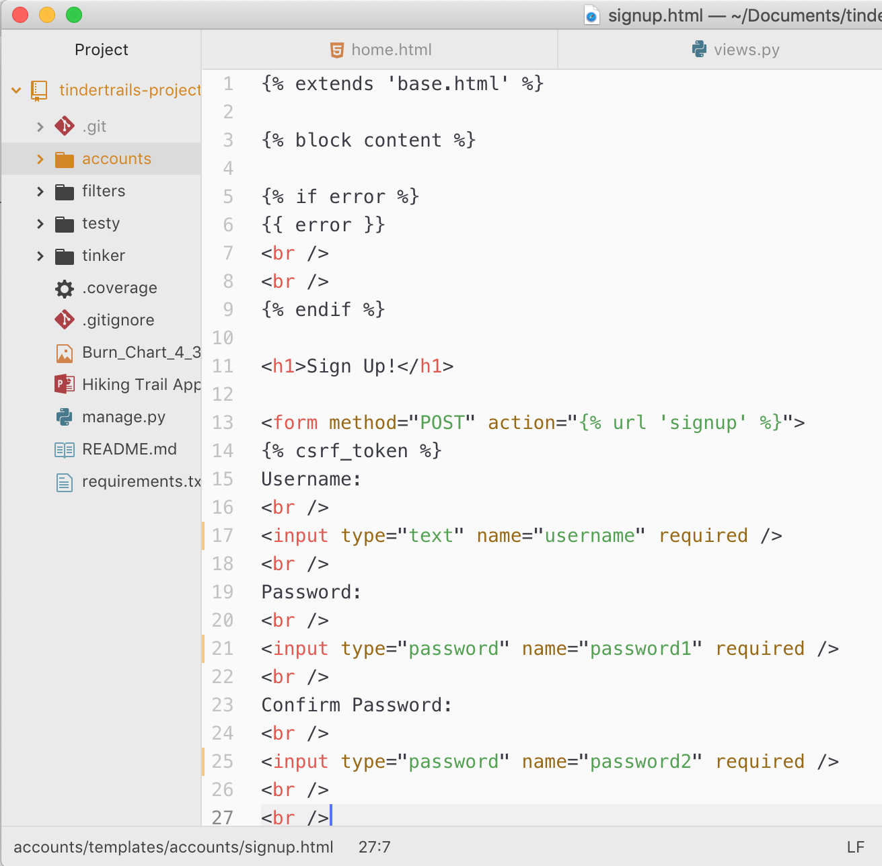
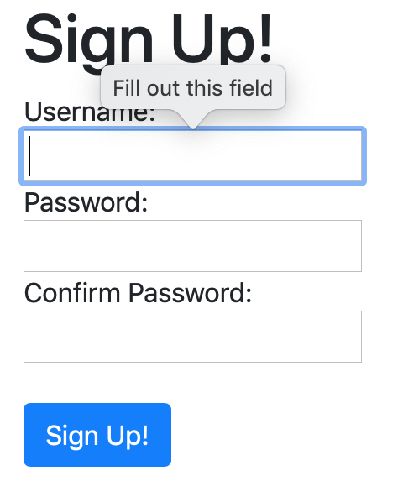
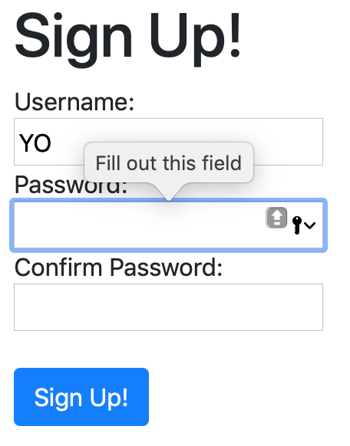
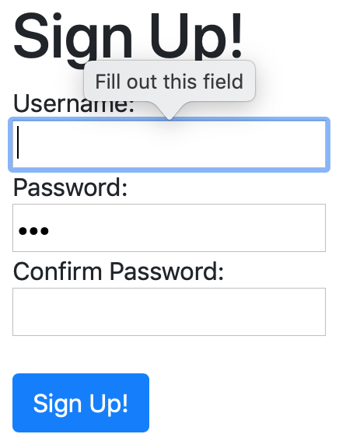
Debug: Sign up with Username or Password Only
(signup.html)

Slide 15
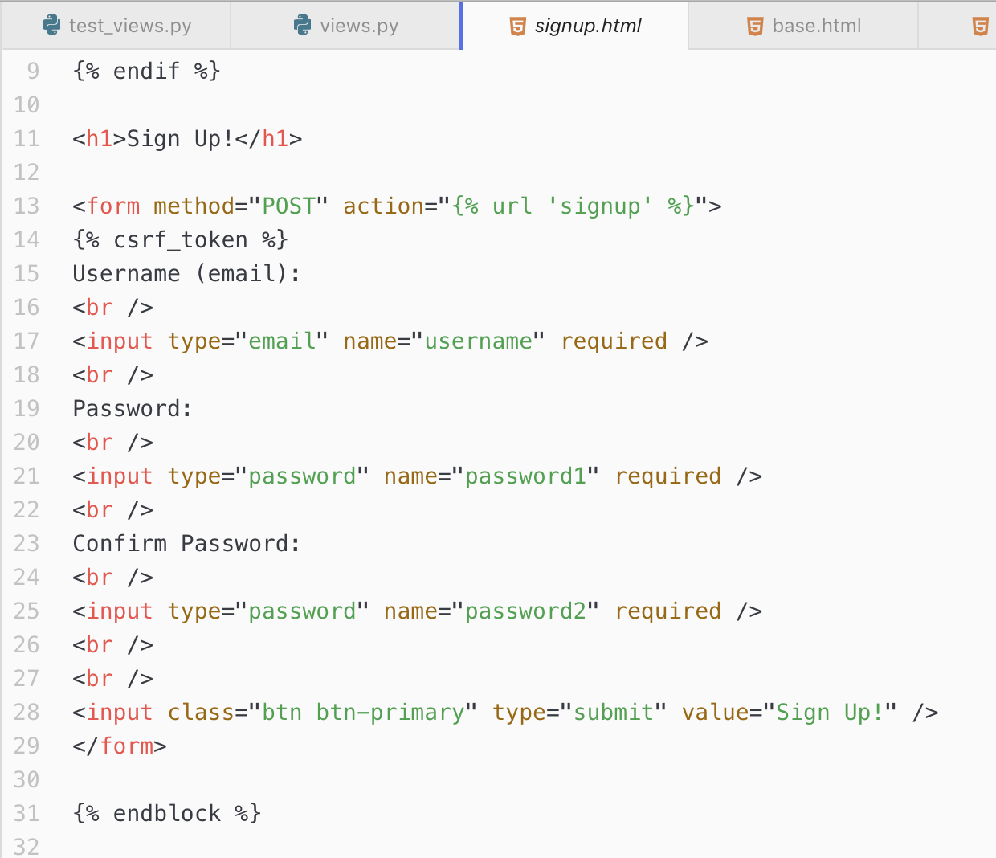
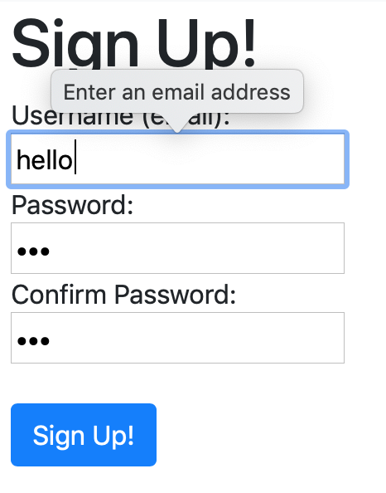
Using Email Address As Username
(signup.html)

Slide 16
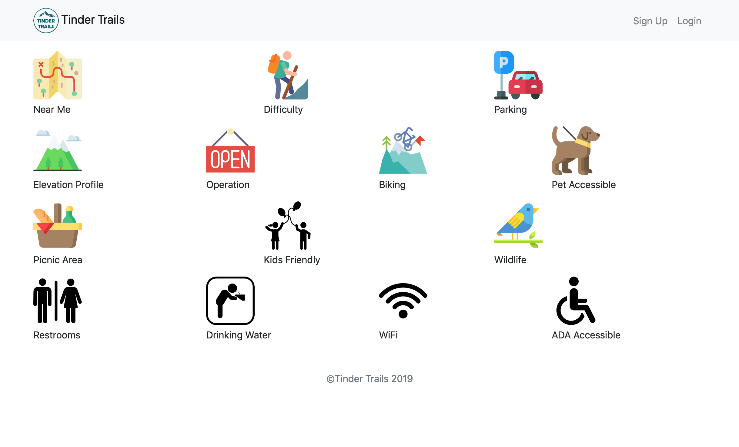
What Everyone Can Do on the Webpage?

Slide 17
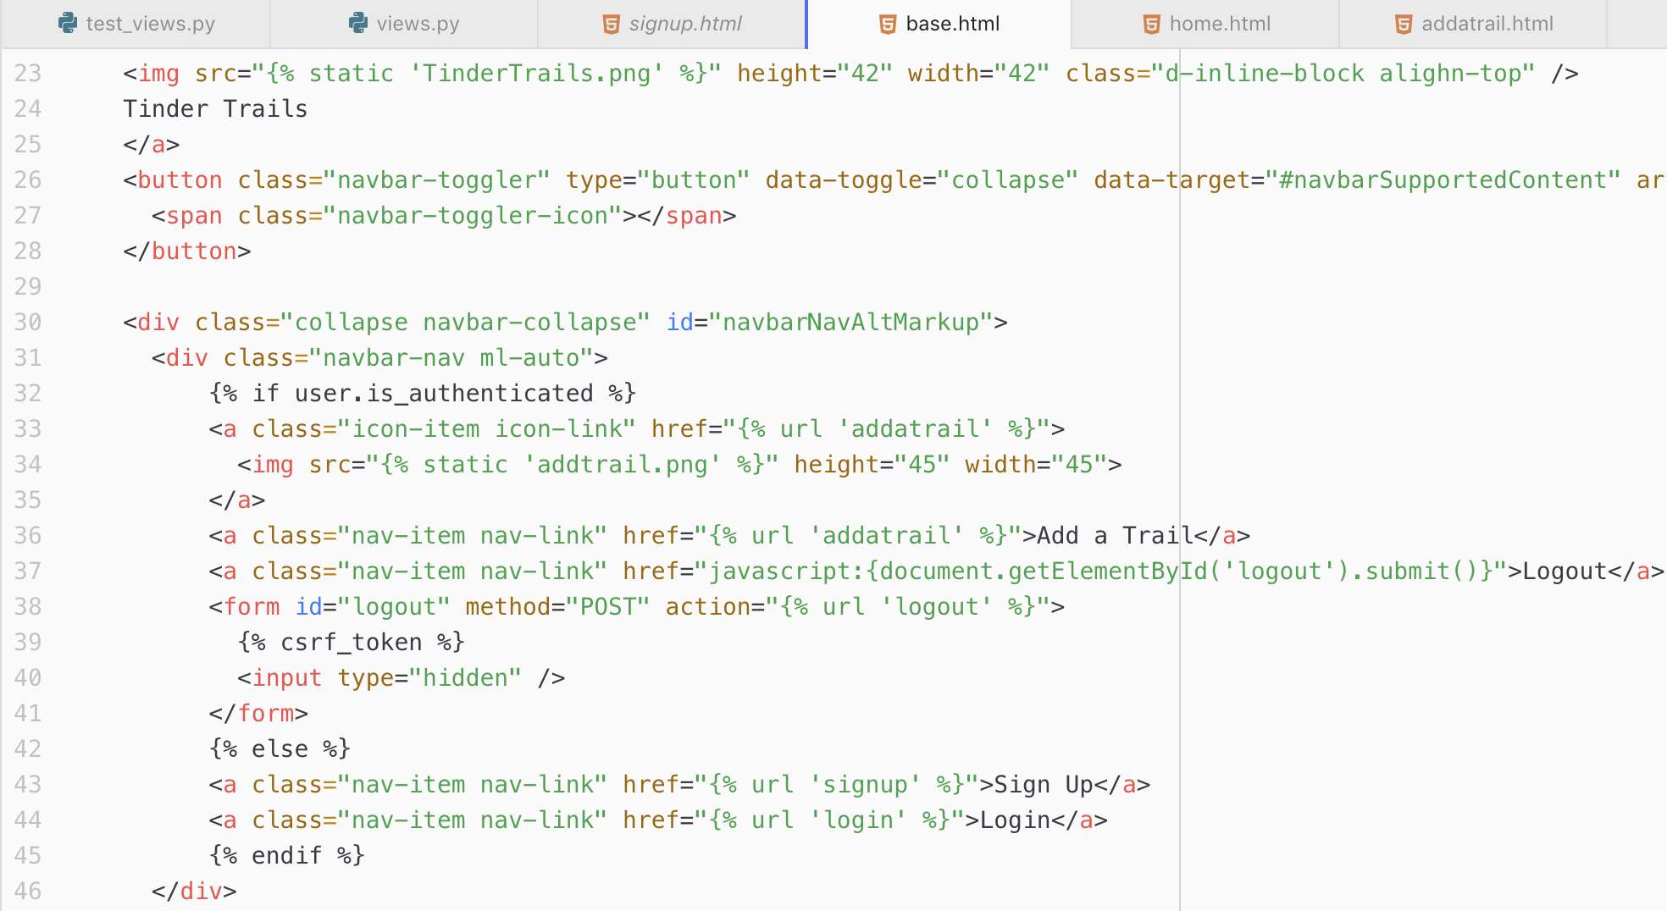
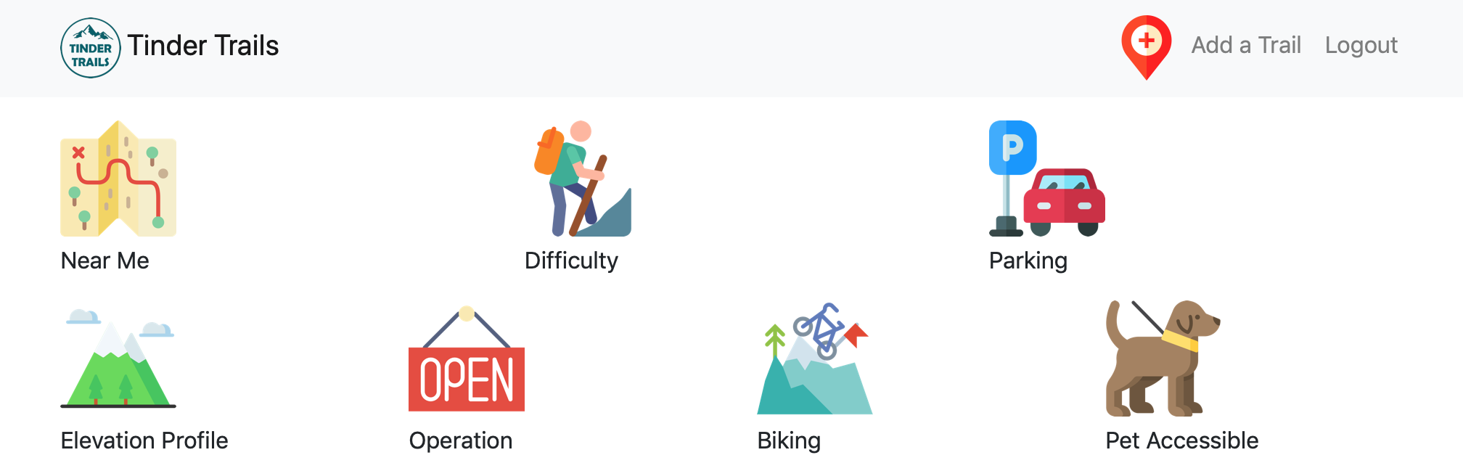
Only the Logged in Users Could Add a Trail
(base.html)

Slide 18
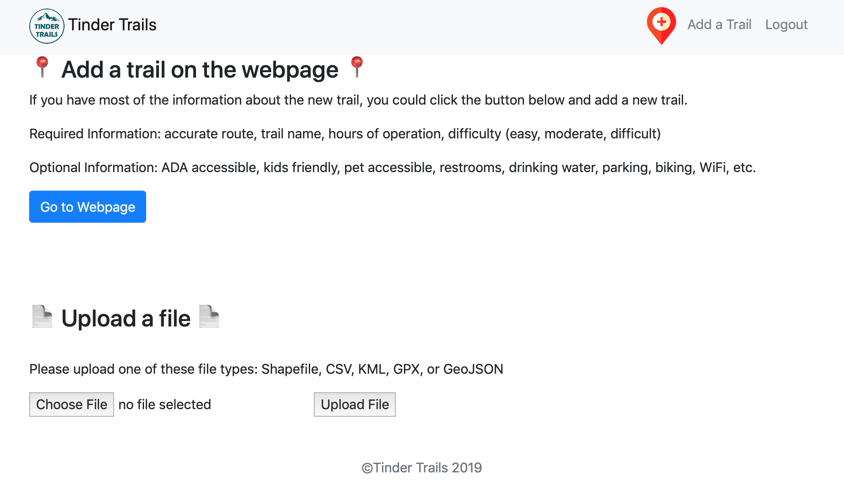
Add a Trail

Slide 19
Pytest DEMO

Slide 20
Future plan (Milestone 3.0)
Deploy our webpage to our domain: http://tindertrails.com
Find way to make user information from Django be connected to ArcGIS server
Find way (if possible) to make the uploaded files from Django automatically create new trails on our ArcGIS map

Slide 21
Q&A
Enjoy the Trails
-Thank You-

Slide 22
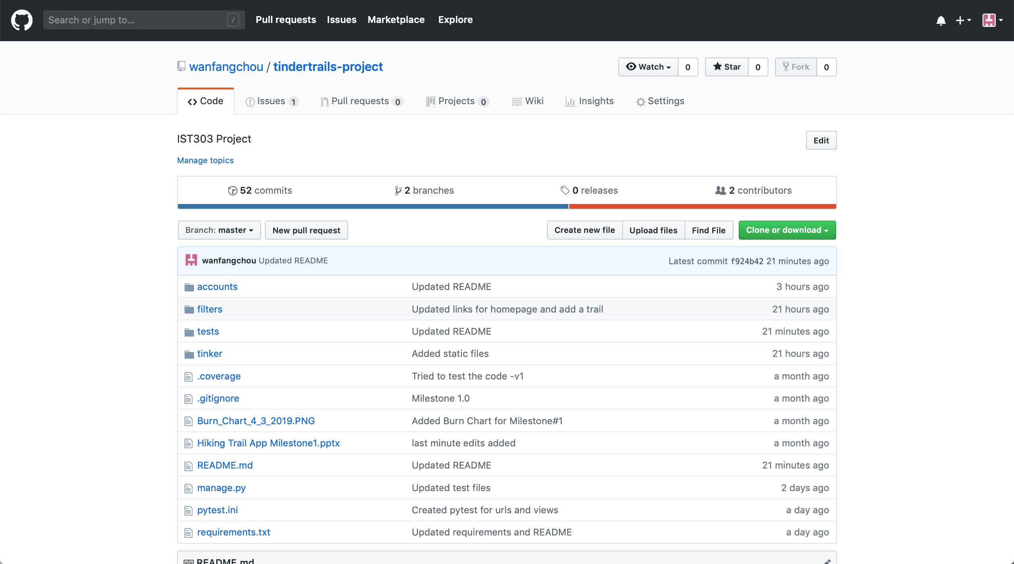
GitHub
https://github.com/wanfangchou/tindertrails-project

Slide 23
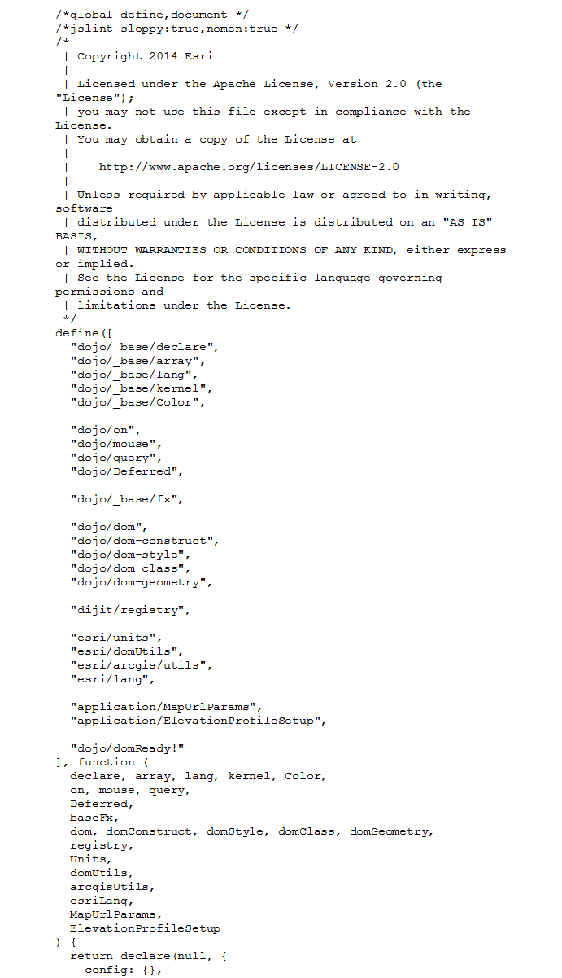
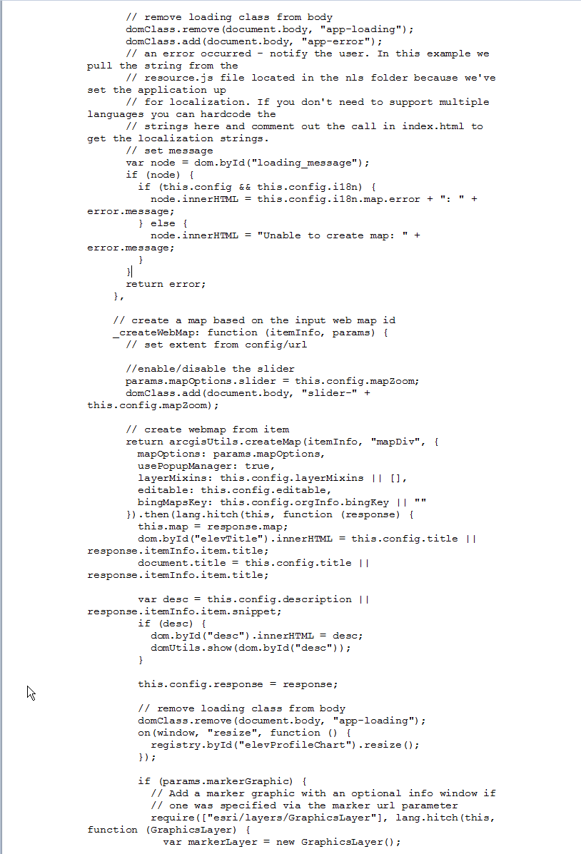
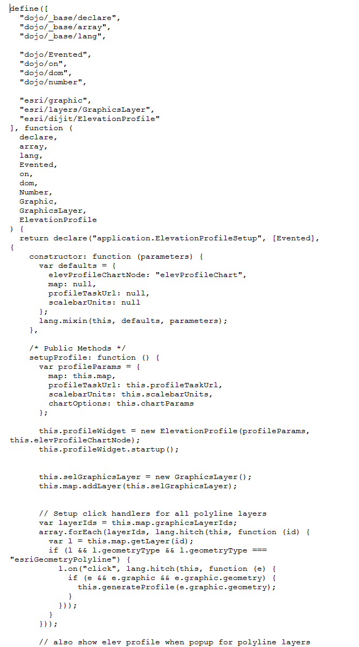
Hiking Trails
code
Walk through

